Slide 1
Medium of Instruction Revisited
Amy B M Tsui
Professor Emerita
Faculty of Education
HK Association of Heads of Secondary Schools
Annual Conference
10 June 2019
CityView Hotel

Slide 2
Outline
What is the model of bilingual education adopted in the MOI policy in HK?
What is the implicit model adopted in the “fine-tuning” MOI policy?
What are the issues in either models?
What does research tell us?
Does CMI restrict or open up students’ opportunities for higher education?

Slide 3
Fig. 1 Early Total Immersion
Fig. 2 Early Partial Immersion
Models of Bilingual Education:
Canadian French Immersion Programs
% time in each language
% time in each language
60-80%
Grade 11/12
…
L1
L2

Slide 4
Fig. 3 Middle Immersion
Fig. 4 Two-Year Late Immersion
% time in each language
% time in each language
L1
L2

Slide 5
Fig. 5 Double Immersion
Variants of Canadian Immersion Models
% time in each language
L1
L2
L3
5

Slide 6
Fig. 6 Two-Way Immersion – Chinese: English (80:20)
80% Chinese (content)
% time in each language
20% English (oracy & literacy)
Chinese
English

Slide 7
Fig. 7 Late Immersion (EMI HK schools)
Fig. 8 Late Partial Immersion (CMI HK schools)
Variants of Canadian Immersion Models
% time in each language
% time in each language
50-80%
L1
L2

Slide 8
Content and Language Integrated Learning (CLIL)
Launched in 1900s in Europe to promote L2 competence and bilingualism, as distinct from immersion borrowed from US and Canada
“Content and Language Integrated Learning (CLIL) is a dual-focused educational approach in which an additional language is used for the learning and teaching of both content and language” (Coyle et al., 2010:1)
Early / late total
Early / late partial
Modular subject
Theme, project, activities
Outside school everyday activities, student exchanges, work-study abroad …

Slide 9
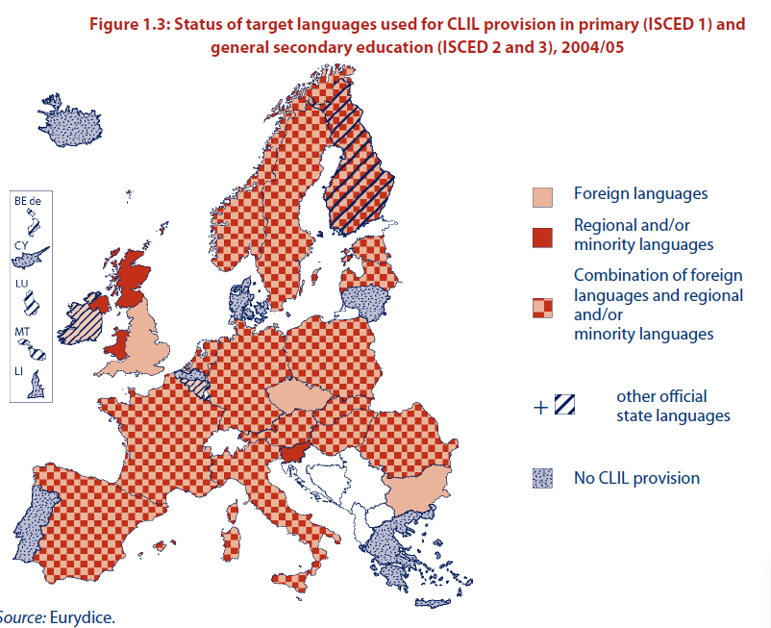

Slide 10
CLIL vs Immersion
Content and Language Integrated Learning (CLIL)
Learning content and target language (any L2, not just English)
Teachers must specialize in content and target language
Million dollar question:
“Can we find enough content teachers who are also language teachers?”
English medium instruction (EMI)
Learning content through English -> improvement in English
Million dollar question:
“…if teachers do not consider themselves language teachers, how is that improvement supposed to happen?”

Slide 11
What does research tell us?

Slide 12
MOI and Students’ Self Concept, Motivation, Learning Strategies and Academic Achievement
EMI vs CMI students – change over 3 years (1999-2001) in:
Self Concept
General Goal Orientation
Motivation
Learning Strategies
Academic Achievement

Slide 13
Self Concept and Learning Strategies
Self concept
General self concept
Motivation
Extrinsic
Intrinsic
Learning strategies
Organization
Elaboration
Critical Thinking
Meta-cognitive Skills
Academic achievement
Math
English
Chinese

Slide 14
Survey Sample
No of Schools | Number of Respondents |  |  | Percentage
 | Male | Female | Total
2 4 3 2 2 | 296 302 247 184 157 | 104 490 410 192 165 | 400 792 657 376 322 | 16% 31% 26% 15% 13%
13 | 1186 | 1361 | 2547 | 100%

Slide 15
General Self Concept & MOI (Comparable Groups: high ability)
Mean scores of general self concept between CMI and EMI students (high ability) across 3 years. (Total no. of Ss: 841)

Slide 16
General Self Concept & MOI (Comparable Groups: average ability)
Mean scores of general self concept between CMI and EMI students (average ability) across 3 years. (Total no. of Ss: 326)

Slide 17
General Self Concept & MOI (by Banding)

Slide 18
Extrinsic Motivation & MOI (Comparable Groups: high ability)
Mean scores of extrinsic motivation scores between CMI and EMI students (high ability) across 3 years (Total no. of Ss: 841)

Slide 19
Intrinsic Motivation & MOI (Comparable Groups: high ability)
Mean scores of intrinsic motivation scores between CMI and EMI students (high ability) across 3 years (Total no. of Ss: 841)

Slide 20
Extrinsic Motivation & MOI (Comparable Groups: average ability)
Mean scores of extrinsic motivation scores between CMI and EMI students (average ability) across 3 years (Total no. of Ss: 326)

Slide 21
Intrinsic Motivation & MOI (Comparable Groups: average ability)
Mean scores of intrinsic motivation scores between CMI and EMI students (average ability) across 3 years (Total no. of Ss: 326)

Slide 22
Extrinsic Motivation & MOI by Banding
Mean scores of extrinsic motivation scores of EMI and CMI students cross 3 years by banding.

Slide 23
Intrinsic Motivation & MOI by Banding
Mean scores of intrinsic motivation scores of EMI and CMI students cross 3 years by banding.

Slide 24
Learning Strategies: Organization (Comparable Groups: high ability)
Mean scores of organization between CMI and EMI students (high ability) across 3 years (Total no. of Ss: 841)

Slide 25
Learning Strategies: Organization (Comparable Groups: average ability)
Mean scores of organization between CMI and EMI students (average ability) across 3 years (Total no. of Ss: 326)

Slide 26
Learning Strategies: Organization by Banding

Slide 27
Learning Strategies: Elaboration (Comparable Groups: high ability)
Mean scores of elaboration between CMI and EMI students (high ability) across 3 years (Total no. of Ss: 841)

Slide 28
Learning Strategies: Elaboration (Comparable Groups: average ability)
Mean scores of elaboration between CMI and EMI students (average ability) across 3 years (Total no. of Ss: 326)

Slide 29
Learning Strategies: Elaboration by Banding

Slide 30
Learning Strategies: Critical Thinking (Comparable Groups: high ability)
Mean scores of critical thinking between CMI and EMI students (high ability) across 3 years (Total no. of Ss: 841)

Slide 31
Learning Strategies: Critical Thinking (Comparable Groups: average ability)
Mean scores of critical thinking between CMI and EMI students (average ability) across 3 years (Total no. of Ss: 326)

Slide 32
Learning Strategies: Critical Thinking by Banding

Slide 33
Learning Strategies: Meta-cognitive Strategies (Comparable Groups: high ability)
Mean scores of meta-cognitive strategies between CMI and EMI students (high ability) across 3 years (Total no. of Ss: 841)

Slide 34
Learning Strategies: Meta-cognitive Strategies (Comparable Groups: average ability)
Mean scores of meta-cognitive strategies between CMI and EMI students (average ability) across 3 years (Total no. of Ss: 326)

Slide 35
Learning Strategies: Meta-cognitive Strategies by Banding

Slide 36
Mathematics Attainment Scores & MOI (Comparable Groups: high ability)
Mean scores of mathematics attainment test of EMI and CMI students (high ability) across 3 years. (Total no. of Ss: ≈ 1000)

Slide 37
Mathematics Attainment Scores & MOI (Comparable Groups: average ability)
Mean scores of mathematics attainment test of EMI and CMI students (average ability) across 3 years. (Total no. of Ss: ≈ 400)

Slide 38
Mathematics Attainment Scores & MOI by Banding

Slide 39
English Attainment Scores & MOI (Comparable Groups: high ability)
Mean scores of English attainment test of EMI and CMI students (high ability) across 3 years. (Total no. of Ss: ≈ 1000)

Slide 40
English Attainment Scores & MOI (Comparable Groups: average ability)
Mean scores of English attainment test of EMI and CMI students (average ability) across 3 years. (Total no. of Ss: ≈ 400)

Slide 41
English Attainment Scores & MOI by Banding

Slide 42
Chinese Attainment Scores & MOI (Comparable Groups: high ability)
Mean scores of Chinese attainment test of EMI and CMI students (high ability) across 3 years. (Total no. of Ss: ≈ 1000)

Slide 43
Chinese Attainment Scores & MOI (Comparable Groups: average ability)
Mean scores of Chinese attainment test of EMI and CMI students (average ability) across 3 years. (Total no. of Ss: ≈ 400)

Slide 44
Chinese Attainment Scores & MOI by Banding

Slide 45
Research on Effects of MOI
Marsh & Hau (2000) Effects of MOI on academic achievement
EMI equally negative irrespective of whether the students were initially more able or less able academically
Students who had higher English proficiency initially were less disadvantaged in geography, history and science
Negative effect of EMI somewhat decreased for history, and less so for science, but did not decrease for mathematics and geography.
Strong emphasis on English in English classes had positive effect on achievements in all six subjects, including Chinese, in English immersion classes

Slide 46
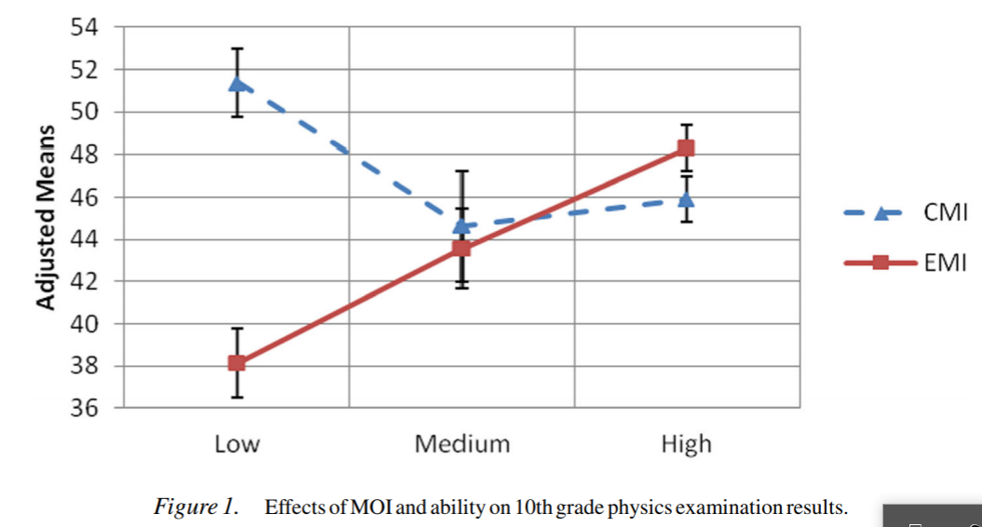
Research on Effects of MOI
Fung and Yip (2014) Effects of MOI on Physics achievement and motivation
CMI school, S4 & S5 – switching to EMI vs retaining CMI

Slide 47
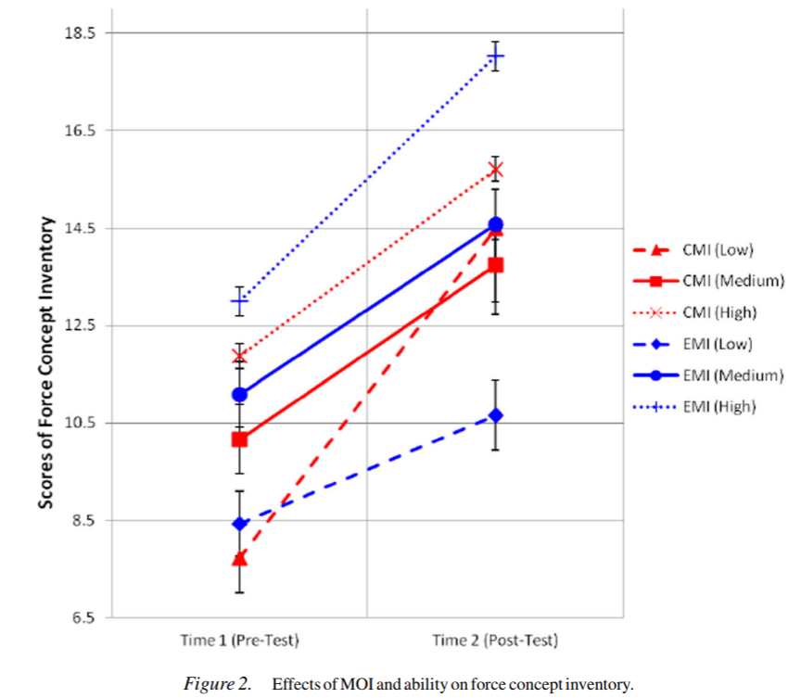
Research on Effects of MOI
Fung and Yip (2014) Effects of MOI on Physics achievement and motivation to learn

Slide 48
Research on Effects of MOI
Fung and Yip (2014) Effects of MOI on Physics achievement and motivation to learn
Questionnaire survey on motivation in learning physics
 | Agree |  | Disagree
 | EMI | CMI | EMI | CMI
Bored in Physics class | 39% | 10% | 56% | 74%
 | 24% (L) | 4% (L) | 7% (L) | 23% (L)
 | 4% (H) | 2% (H) | 28% (H) | 27% (H)
Look forward to Physics class | 47% | 86% | 37% | 3%
 | 7% (L) | 27% (L) | 24% (L) | 2% (L)
 | 25% (H) | 31% (H) | 6% (H) | 0% (H)
L= Low physics ability H= High physics ability

Slide 49
MOI and Opportunities for Higher Education

Slide 50
Percentages of candidates using Chinese as a medium in public examinations
Two reasons for steady increase in the percentages of students using Chinese as a medium in public exams:
Ss who used CME scored better than their EME counterparts in a number of subjects.
HKEAA data: a ‘notable and continuous increase’ in the percentage of CMI students obtaining 5 passes and 14 points or above in six best-performed subjects.
Shift in assessment
Factual Qs -> data interpretation, argumentation, and reasoning
Stronger demand on language: difficult for Ss weak in English to cope with EME

Slide 51
Language Experience at school of HKU UG (2007)
Q1. MOI at Secondary School by Level by Subject
Level | Subject Category | Textbook |  | Classroom |  | Exam
 |  | Chi | Eng | Chi | Eng | Chi | Eng
S1-3 | Science | 9.8% | 90.6% | 26.3% | 78.9% | 9.8% | 90.5%
 | Humanities | 13.7% | 86.6% | 25.8% | 77.3% | 13.5% | 86.7%
 | Math | 10.0% | 90.5% | 26.0% | 79.2% | 10.5% | 89.5%
 | Civic Edu. | 31.2% | 69.4% | 43.1% | 60.3% | 26.2% | 73.8%
S4-5 | Science | 7.7% | 92.4% | 27.1% | 78.1% | 7.9% | 92.2%
 | Humanities | 11.7% | 88.3% | 22.0% | 80.9% | 11.5% | 88.5%
 | Math | 6.3% | 93.8% | 25.3% | 80.9% | 6.8% | 94.0%
 | Religious Stud. | 34.4% | 66.7% | 39.7% | 61.7% | 33.0% | 67.0%
 | Others | 33.7% | 69.8% | 41.1% | 67.8% | 29.2% | 73.0%
S6-7 | Science | 8.5% | 91.6% | 27.8% | 77.8% | 8.7% | 91.4%
 | Humanities | 15.6% | 84.5% | 26.6% | 74.8% | 15.4% | 84.6%
 | Math | 9.9% | 90.1% | 27.3% | 79.4% | 10.0% | 90.0%
 | Liberal Studies | 38.4% | 62.8% | 45.2% | 54.8% | 38.1% | 63.1%
 | Others | 44.3% | 59.0% | 51.6% | 53.1% | 40.3% | 61.3%

Slide 52
Language Experience at school of HKU UG (2007)
by Faculty
Consistently higher percentages of CMI in Faculties of Business & Economics and Science at all levels
Higher percentages of CMI in some of the subject categories in the Faculty of Dentistry.
Majority of students in Faculties of Medicine had EMI in secondary schools.
Also high percentage of EMI in Faculty of Architecture in junior forms and Faculties of Arts and Social Sciences in senior forms.

Slide 53
MOI : Mediating factors
Age for L2 Immersion and Linguistic Interdependence
L2 Threshold level
L1 literacy level and linguistic interdependence
Quality of teaching in immersion Classrooms:
Teachers’ English competence
Language awareness of English and content teachers (Hoare 2004)
3. Language Support and L2 Curriculum (Walker 2010)
4. Pedagogy: Language Ability and Cognitive Challenge

Slide 54
Language Support and L2 Curriculum
Walker (2010): English Enrichment Program in CMI schools in HK
Enrichment Program for students switching from CMI to EMI in S4 : 2 years prior to switching, 1hr session after school, once or twice a week; 60 modules on a variety of topics using EMI
Compared EP Ss and non-EP Ss’ performance in 2 scientific English tasks 4 months after transitioning from CMI to EMI
Findings:
EP Ss did not perform better than non-EP Ss

Slide 55
Language Support and L2 Curriculum
Walker (2010): Reasons for ineffectiveness of EP
Lack of explicit focus on language
Lack of awareness of the subject specific linguistic features on the part of content teachers
Curriculum materials either not subject-specific enough for EP science teachers or too subject-specific for the EP English teachers

Slide 56
Pedagogy: Language Ability and Cognitive Challenge
Immersion / CLIL classrooms: teacher-centered, didactic teaching attributed to students’ low proficiency in L2
Didactic teaching and low cognitive challenge
 | EMI (N = 37) |  | CMI (N = 47)
Question Types | + response | - response | + response | - response
Closed Questions (blank filling) | 20 (54%) (11)(55%) | 4 (10.8%) (4) (100%) | 25 (53.2%) (6) (24%) | 2 (4.3%) (0)
Open Questions | 7 (18.9%) | 6 (16.2%) | 16 (34%) | 4 (8.5%)
Total | 27 (73%) | 10 (37%) | 41 (87%) | 6 (12.8%)
Question Types in Physics Lessons (EMI vs CMI) taught by same teacher
Source: Ng, Tsui and Marton (2001)

Slide 57
Concluding Remarks
For Ss of high academic ability, EMI has little adverse effects on their academic achievement.
For Ss of average and low academic ability, CMI is beneficial to their academic achievement.
Using a stronger language to learn has a positive effect on students’ self-concept, motivation, and learning strategies.
For adoption of EMI or CLIL, the following preconditions must obtain:
Content teachers’ English competence
Content teachers’ knowledge about the linguistic demand of the content subject taught through English
Content subject curricula must include language
The gap between the English curriculum and the linguistic demands of content subjects
Transitioning from English for everyday communicative purpose to English for academic purpose

